Slide 1
February 2019
ET Professional Monitors

Slide 2
Contents
Inflation | 3
Central Bank Omnipotence | 9
Trade and Tariffs | 15
US Fiscal Policy | 21
Credit Cycle | 27
Guide to Use | 33
Disclaimers | 36

Slide 3
Inflation Commentary
After a bit of a fade in late 2018, Inflation continues to show its presence in the background of more cohesive, higher attention narratives in early 2019.
Despite the increase in cohesion, and despite our belief in the long-term shift in Zeitgeist toward inflation, we don’t think there is a coherent short-term inflation narrative at this time.
What we DO see are persistent emerging concentrations of inflation stories – both consumer prices and wage pressure-driven, in a few key areas:
Health care and pharmaceuticals;
Education; and
Transportation.
We haven’t seen major changes in either sentiment or fiat news content to give us much concern about an inflection point for Inflation narratives at this time.

Slide 4
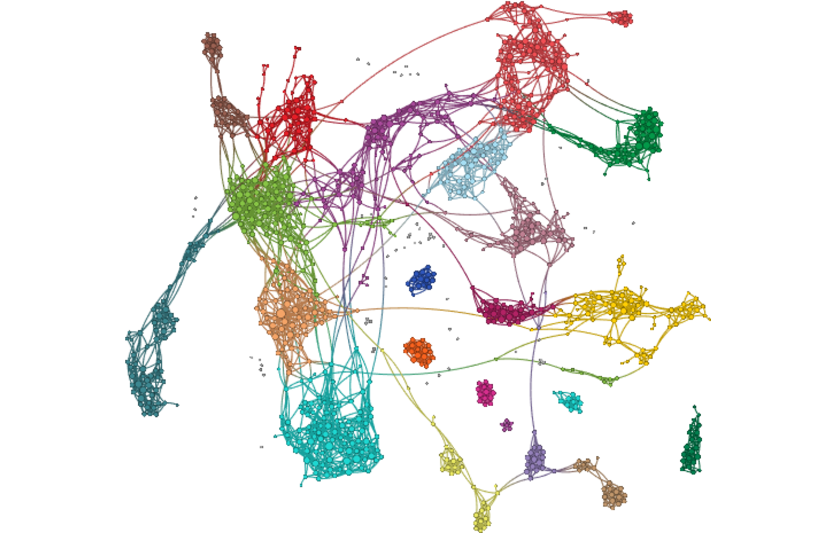
Inflation Network Map – February 2019
Economic Data, Falling Retail Sales, Low Gas Prices, Wage Gains Cool, Producer Prices Drop
Earnings Impacts: Higher Input Costs, China Consumer Hit “Overblown”
European / EM Central Banks, “Rate Cuts Back in Play”, Greek “Pause” on Fiscal Paralysis
ECB, “Could Change if Outlook Worsens”, “Policy Restraint if Growth Slows”
Inflated Prices, Esp. Drugs, Energy, Health Care, “US Can Take on a Lot More Debt"
India, Cuts “Could Be In Store”, Inflation Eases
EM, Canada and Australia, Trade Optimism, Warnings on Housing
Brexit, No-Deal, Referendum, “Divorce”, “Need for Certainty”, Rising Energy
Impact on Funds, Fed Pivot, “Beating Back Bears”
Fed, Powell, “Pivot”, “Wait and See”, Balance Sheet

Slide 5
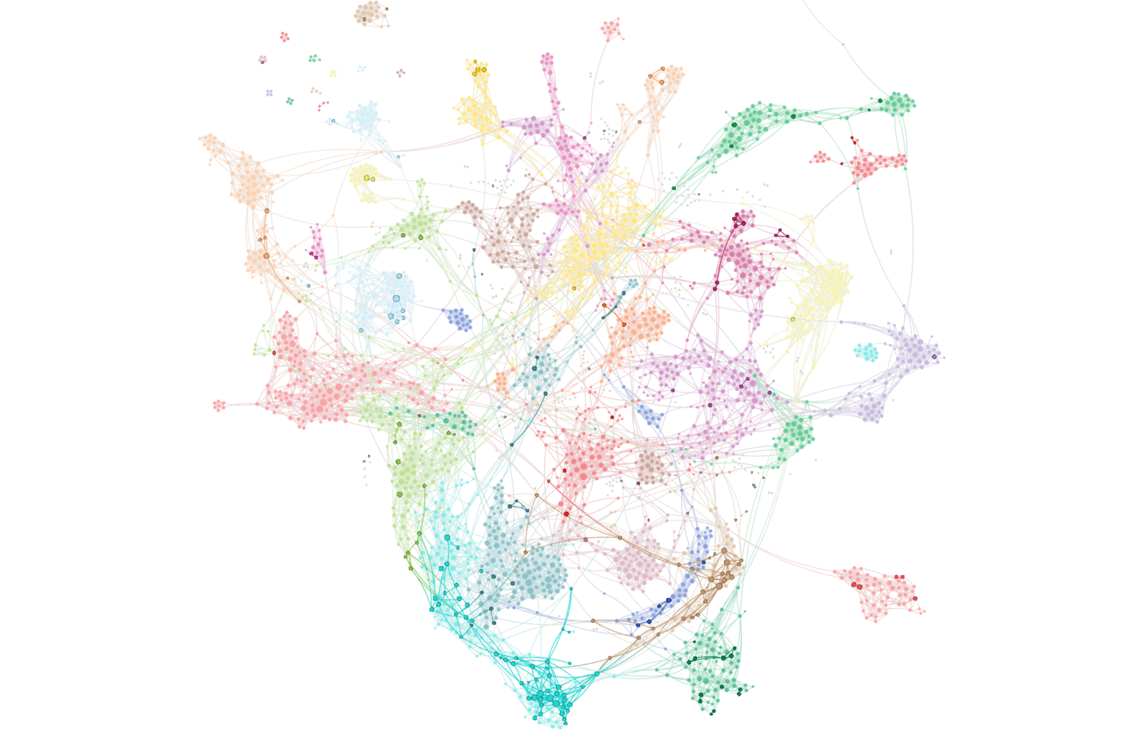
Inflation Attention – February 2019
Full network reflects all articles referencing stocks/equities. Bold-faced nodes represent articles discussing inflation, producer prices, wage pressures and costs.

Slide 6
Inflation Cohesion Monitor – February 2019

Slide 7
Inflation Fiat News Monitor – February 2019

Slide 8
Inflation Sentiment Monitor – February 2019

Slide 9
Central Bank Omnipotence Commentary
Central Bank Omnipotence narratives continued their rapid ascent in February.
We now think that this – more than trade and tariffs – is the primary governing narrative of risky asset markets in the US.
Our spot calculation in February was the single highest measure we have seen in any monitor. Our cohesion measure would describe nearly 70% of nodes as being highly connected!
The narrative as we see it is this: The Fed Put is Back.
After December’s horror at the prospect of a maybe-not-so-dovish Fed, sentiment has rebounded rapidly as well. The markets and media have happily embraced the new Fed and the new narrative of its omnipotence.
We also note that language used in European and UK/Brexit-related central bank commentary has converged significantly.

Slide 10
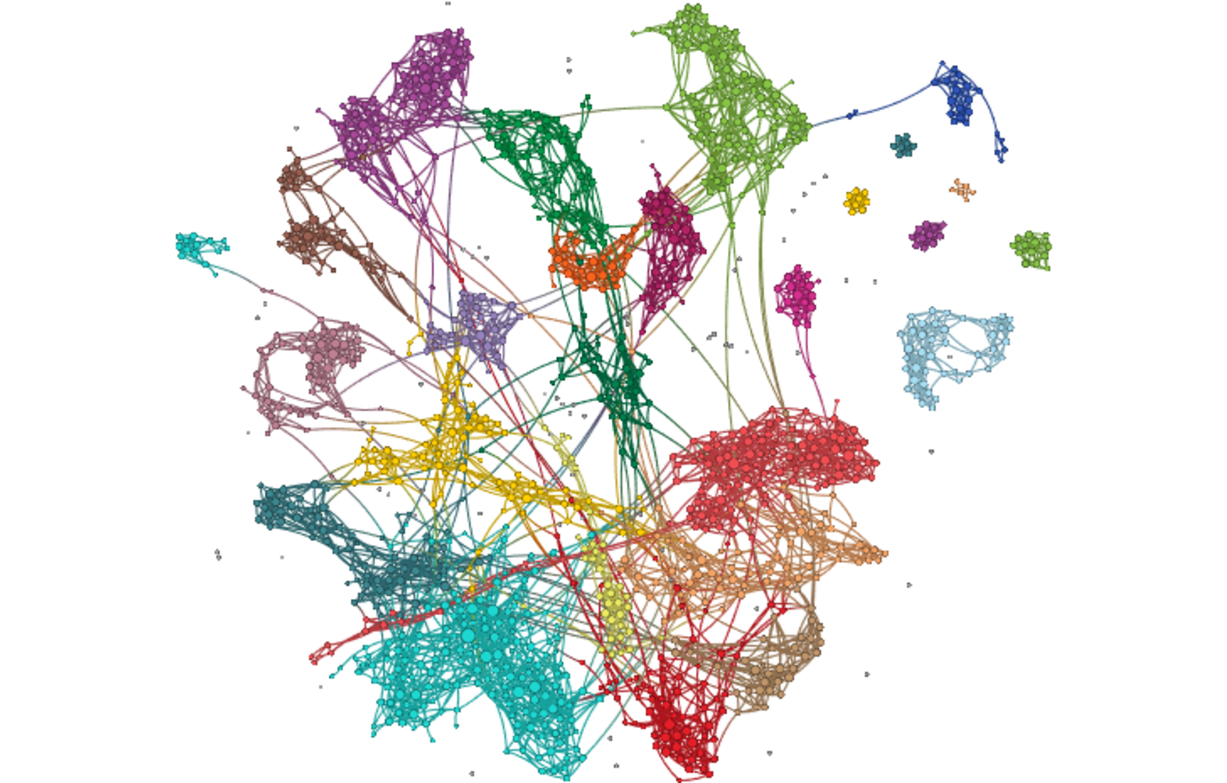
Central Bank Omnipotence Network Map – February 2019
ECB Board Shuffling, France leading Draghi replacement, ‘Careful what you wish for’
Brexit, Uncertainty, British investing in EU, UK Wage Pressures, ‘Hold their nerve’
ECB, ‘Could change rate guidance’, Italy Debt Crisis, Germany ‘escapes recession’
Trade War, Growth Concerns Prop Dollar
Italy bond highs, 30-year bonds, negative yields
Market Trade War Writeups (Up on Trade Hopes, Down on Trade Fears)
Asia, Trade War, Intellectual Property,
Bank, regulatory chaos post-Brexit
Fed, ‘Patience’, ‘Wait and See’, Balance Sheet Trimming ‘Should End’
Leveraged debt markets “wait” for PE trillions, corporate bonds “on fire” after Fed signal, China open to capital
Inequality, Yellen on Trump, Dems target rich
Auto loan delinquencies, ‘explosion’ in origination
Econ Data: Consumer Prices Flat, Wage Growth “Higher than we think”, retail sales plunge
IG Rally, HY Rally, “Investors buying stocks and bonds at same time”

Slide 11
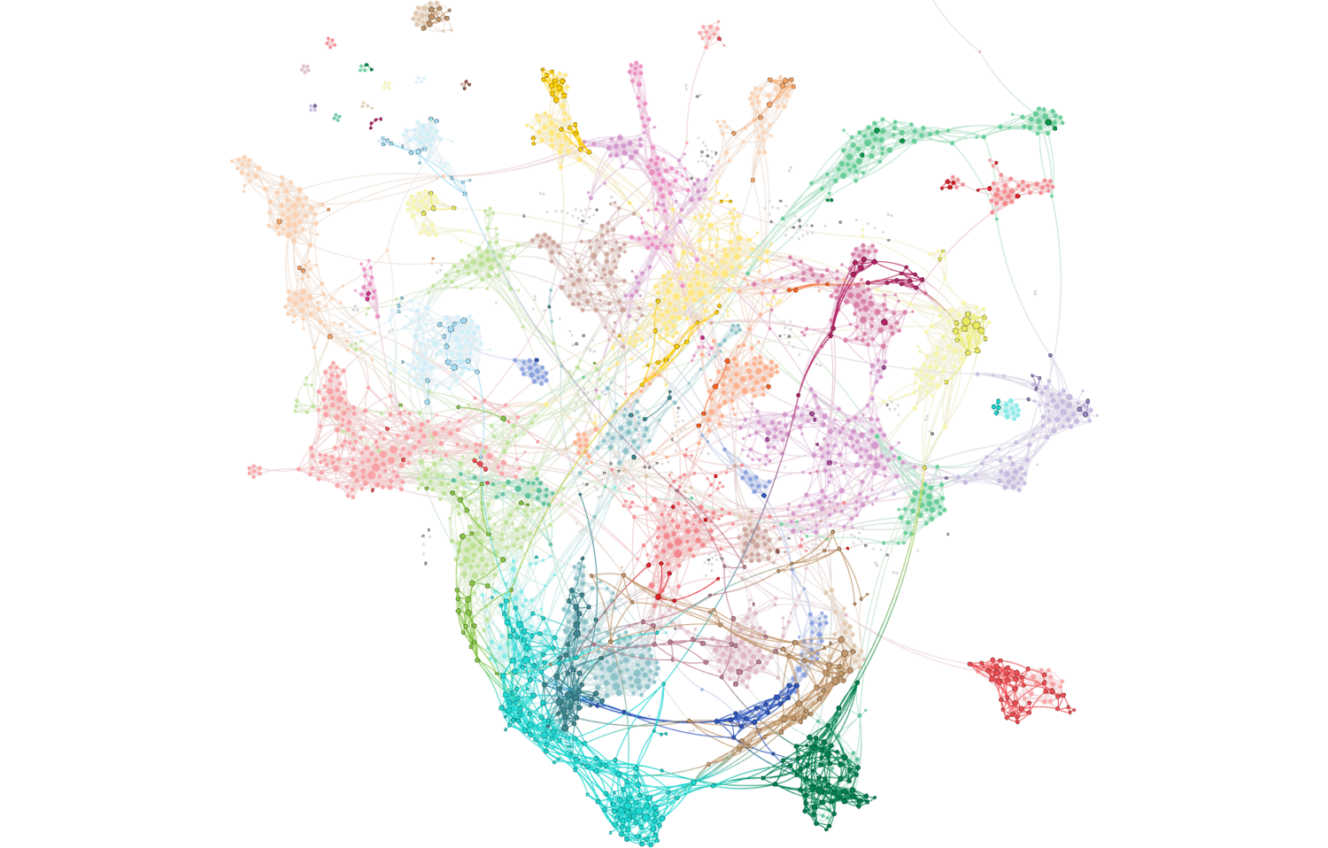
Central Bank Omnipotence Attention – February 2019
Full network reflects all articles referencing stocks/equities. Bold-faced nodes represent articles discussing the Fed, ECB, BOJ, BOE and other global central banking policy.

Slide 12
Central Bank Omnipotence Cohesion Monitor – February 2019

Slide 13
Central Bank Omnipotence Fiat News Monitor – February 2019

Slide 14
Central Bank Omnipotence Sentiment Monitor – February 2019

Slide 15
Trade and Tariffs Commentary
Cohesion around Trade and Tariffs narratives has gone into some decline in early 2019, in our view because (1) markets are more clearly discounting a positive outcome and (2) because central bank omnipotence has taken over as the primary governing narrative in the U.S.
The effect is a narrative map with more distance between discussions of equity and credit markets and discussions of trade – we note that the trade discussions continue to be high stakes and loaded with national security language.
The narrative still has decent cohesion, but coupled with the spike in sentiment, we would feel comfortable calling this an increasingly complacent narrative structure from a markets perspective.
What does that mean?
It means that if you have a divergent (i.e. more negative) odds view on outcomes, you may have asymmetric payoff opportunities.
We still don’t think anyone is likely to have justifiable confidence in such an view on the odds on outcomes.

Slide 16
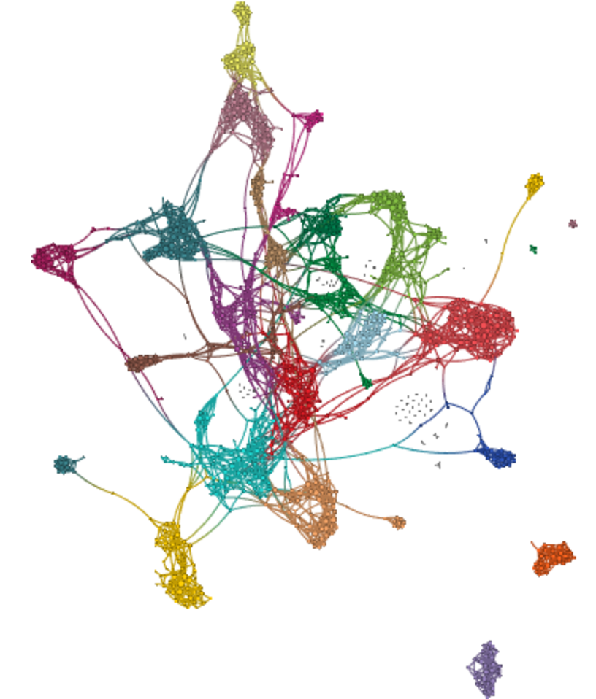
Trade and Tariffs Network Map – February 2019
Corbyn, Northern Ireland Backstop
National security, esp. Europe, Germany and NATO
Brexit, No-Deal, Uncertainty
Nuclear independence, military, Russia, Kim, ‘nightmare’
Ag / Soy Exports
Energy exports
National security, steel and aluminum
Sales, profits disappoint, esp. exporters
Trump / Xi extension, ‘meet soon’, ‘verge of historic’, enforcement
Bond rallies, monetary stimulus in response to trade risks
Democrats, Warren, ‘fixes for capitalism’
Buffett/Apple hit, Trade Deal developments, recession risk
Weak econ data, consumer spending, small business confidence decline, weak exports

Slide 17
Trade and Tariffs Attention – February 2019
Full network reflects all articles referencing stocks/equities. Bold-faced nodes represent articles discussing trade, tariffs, duties and associated agreements and negotiations.

Slide 18
Trade and Tariffs Attention Monitor – February 2019

Slide 19
Trade and Tariffs Fiat News Monitor – February 2019

Slide 20
Trade and Tariffs Sentiment Monitor – February 2019

Slide 21
US Fiscal Policy Commentary
Cohesion of US Fiscal Policy topics remains somewhat elevated.
This appears to be the result of a sustained national discussion about the Green New Deal, Modern Monetary Theory, sustainable levels of debt and the impact on financial markets.
We do think there IS a US Fiscal Policy narrative: “Debt doesn’t matter, so let’s do what we have to do to prevent [insert existential threat here].”
We think it coexists with the growing inflationary zeitgeist only because they are being promoted by isolated missionary groups.
To that end, we note that the Fiscal Policy discussions are almost completely bereft of financial market linkages. US debt levels are simply NOT relevant to any active discussion of equity, credit or even rates, for the most part. For that reason, while there is an emerging narrative, we think markets are still complacent to it.

Slide 22
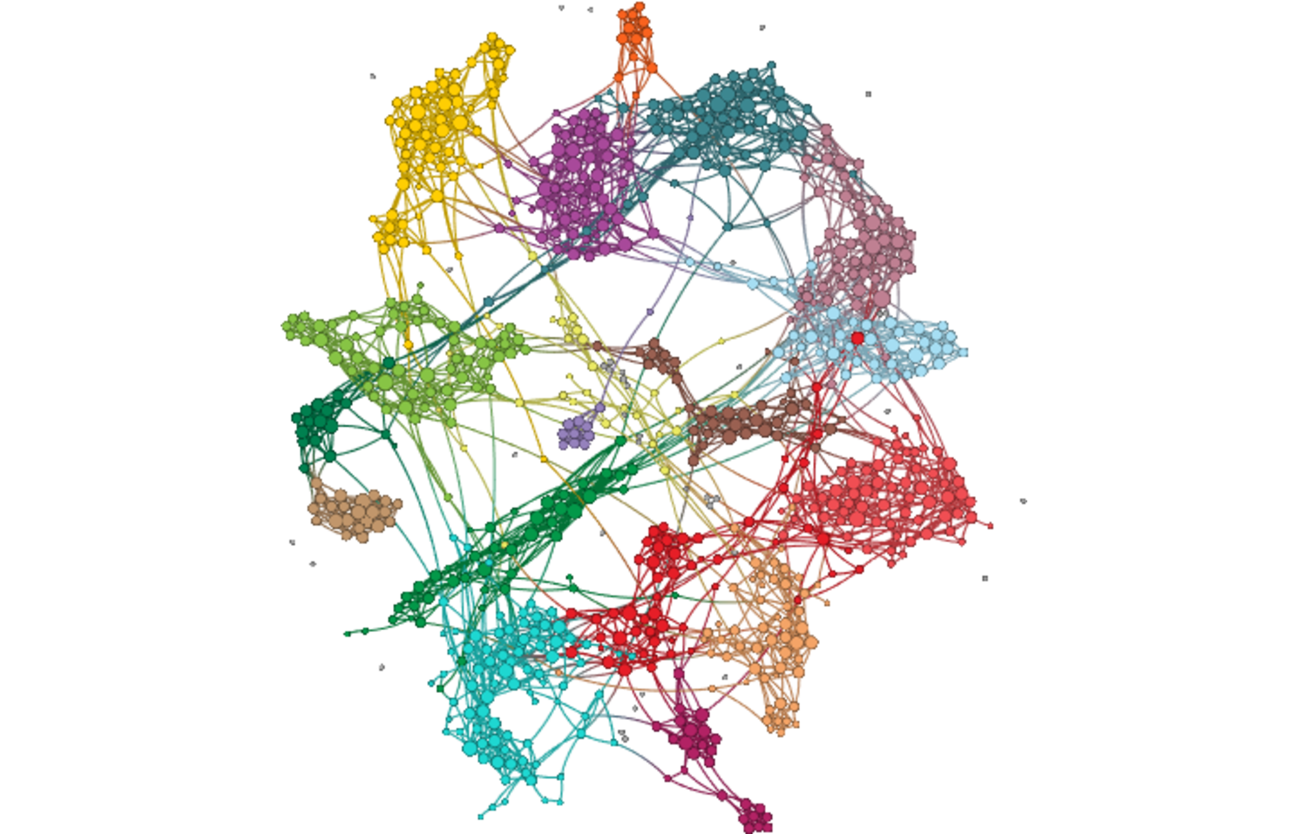
US Fiscal Policy Network Map – February 2019
EM, ‘Avoid Credit Downgrade’, Growth Concerns, IMF
Investment analysis of debt, MMT issues, Gold
Euro Area, Italy Debt Crisis, Fiscal Austerity
MMT, Government Debt, ‘Debt rising, concern isn’t’, ‘US Can Take on More Debt’
Border Wall, Detention Beds, Shutdown
CBO, ‘Soaring’ deficit, flat revenues, ‘missed’ growth targets
Green New Deal, Greenhouse Gases, Emissions
Earnings from Major Fed Gov’t Contractors
Kamala Harris, Socialism, Starbucks, UBI, ‘Soak the rich’
Spending Caps, Nat’l Debt as Security Issue
Federal investigations, special counsel
Health coverage, esp. Federal EEs
Pritzker, Illinois Budget Woes
Student loans, teachers

Slide 23
US Fiscal Policy Attention – February 2019
Full network reflects all articles referencing stocks/equities. Bold-faced nodes represent articles discussing fiscal deficits, the US federal budget and national debt matters.

Slide 24
US Fiscal Policy Cohesion Monitor – February 2019

Slide 25
US Fiscal Policy Fiat News Monitor – February 2019

Slide 26
US Fiscal Policy Sentiment Monitor – February 2019

Slide 27
Credit Cycle Commentary
As we noted in our Zeitgeist post on March 4, we see the rather unseemly search for yield among many large institutions (and not just in Japan), but neither see the fundamental case or narrative of systemic risk at this point.
There is little idiosyncratic cohesion within credit market narratives – we frankly see most of these discussions as a derivative of risky asset drivers more broadly, which is to say heavily influenced by central bank omnipotence narratives.
The most centrally connected cluster here IS the central bank pivot-focused cluster, not a cluster relating to issuance, structured credit, leveraged loans, auto delinquencies or mortgage concerns in Aussie, Canada or UK.
Other on-again / off-again topics like student loans and household borrowing remain muted.

Slide 28
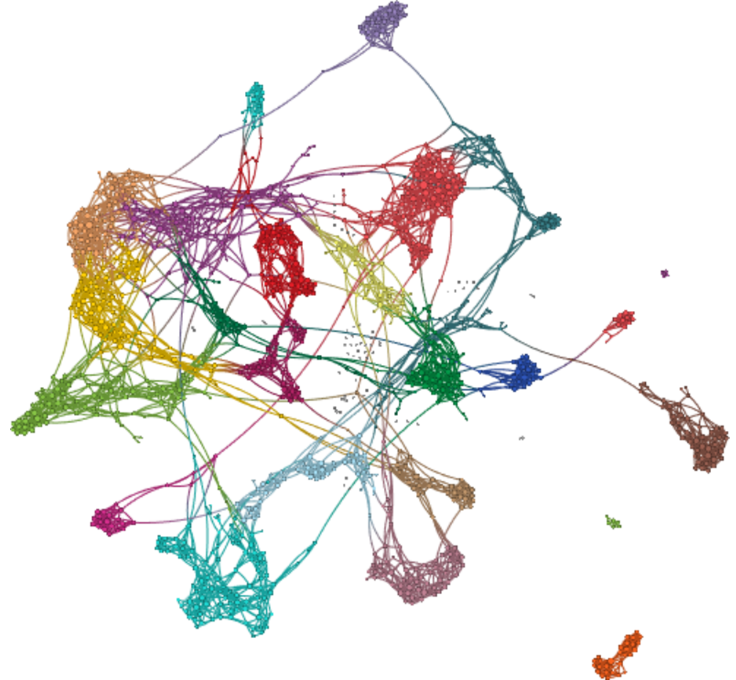
Credit Cycle Network Map – February 2019
Bank Earnings
Slowing global economy, China slowdown, falling global credit impulse
Fintech, banking technology and blockchain
Retail and small business lending
‘Fed Put is Real’, Pivot in Monetary Policy, ‘Economy isn’t driving debt markets’
Junk defies recession signals, credit spread confusion, play defense?
BDC, Credit and Specialty Lending Earnings
Auto loans bad, everything else peachy
Issuance, Investors ‘flood in’, new subprime boom, demand exceeds supply of hybrids, regulatory scrutiny of leveraged loans
Consumer Credit, Student Loans
Reinsurance earnings, results, capital markets activity
India, reducing loan load, small business restructuring, ag lending plans

Slide 29
Credit Cycle Attention – February 2019
Full network reflects all articles referencing the credit cycle, changes in spreads, liquidity, debt issuance and defaults / delinquencies.

Slide 30
Credit Cycle Cohesion Monitor – February 2019

Slide 31
Credit Cycle Fiat News Monitor – February 2019

Slide 32
Credit Cycle Sentiment Monitor – February 2019

Slide 33
Text Analytics Background

Slide 34
How to Read a Network
Quid creates a visual map to represent the landscape. Example network: sized by degree, colored by cluster.

Slide 35
ET Professional Terminology
Cohesion is an Epsilon Theory-only measure which uses a Djikstra Algorithm to find the shortest distance between each node (article) pair, and measures the normalized harmonic centrality of the entire network of those pairs. Think of it as a measure of the similarity between all articles on a topic. It is measured between 0-1, and should not be compared between topics, which may be naturally more or less similar because of the nature of the topic as defined.
Sentiment is a Quid-based measure based on scores of the positive or negative characteristics of each n-gram (phrases, words, etc.). Our measure is calculating as (% net positive – % net negative) / (% either positive or negative).
Fiat News is an Epsilon Theory-only measure of the use of words or phrases which communicate assertions of casuality, value judgments or self-evidence (e.g. “obviously”). We use it to measure the aggregate tendency of articles to explain content, which can sometimes be related to periods of heightened narrative promotion.
Narrative Maps are Quid-driven content, but the categories and cluster titles are based on Epsilon Theory analysis of the underlying articles’ content and Quid-identified n-grams.

Slide 36
Disclaimers and Use
This analysis is prepared as general research and commentary, and is not a recommendation to buy or sell any security. It does not take into account individual facts and circumstances, and should be supplemented by additional such analysis to guide any investment decisions.
If you are an ET Professional Subscriber, you may use these slides for personal or commercial use in any client presentation at which the subscriber is present.
In those uses, you may modify the slides to use your branding and format, provided that Epsilon Theory and Quid are described as sources on those pages (footnotes are fine).
You may not distribute these slides publicly (e.g. on Social Media, on your website, etc.) without the permission of Epsilon Theory.

